Slide 1


Slide 2
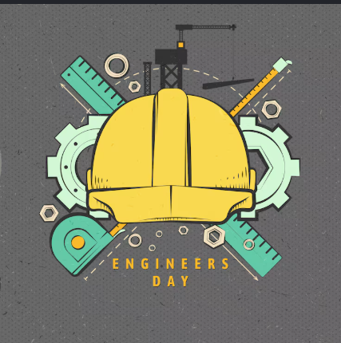

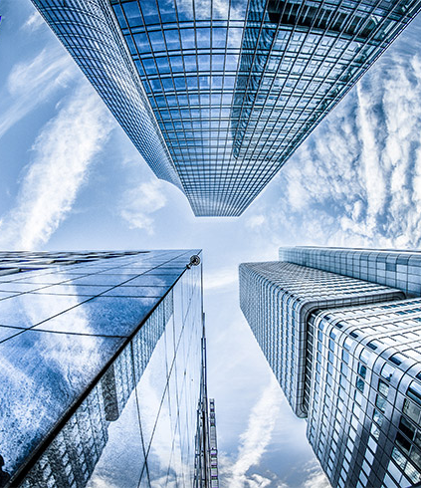
Shaping the Future Through Intelligent Innovation
AI
“Exploring Technology That Is Transforming Tomorrow”
Arnav Sinha roll no= 87264022
Sonu kumar roll no =87264044
Branch:-Electrical and Electronics Engineering [EEE]

Slide 3
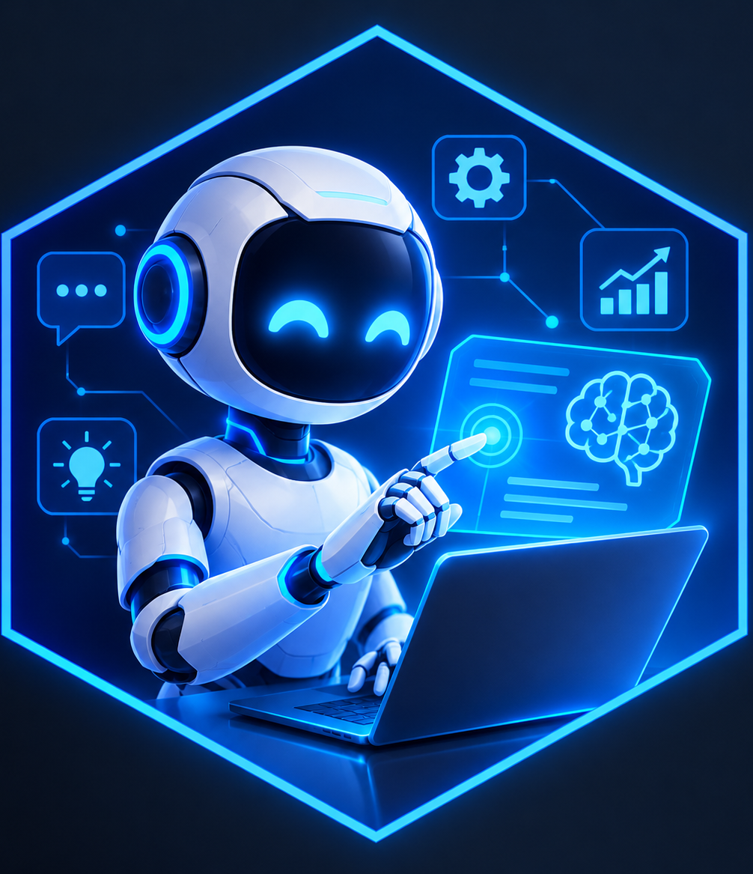
Section Divider
AI
Title Slide — AI & Emerging Technologies
Introduction — What is AI?
Types of AI
Applications of AI
Benefits, Challenges & Future Scope
Conclusion / Thank You

Slide 4
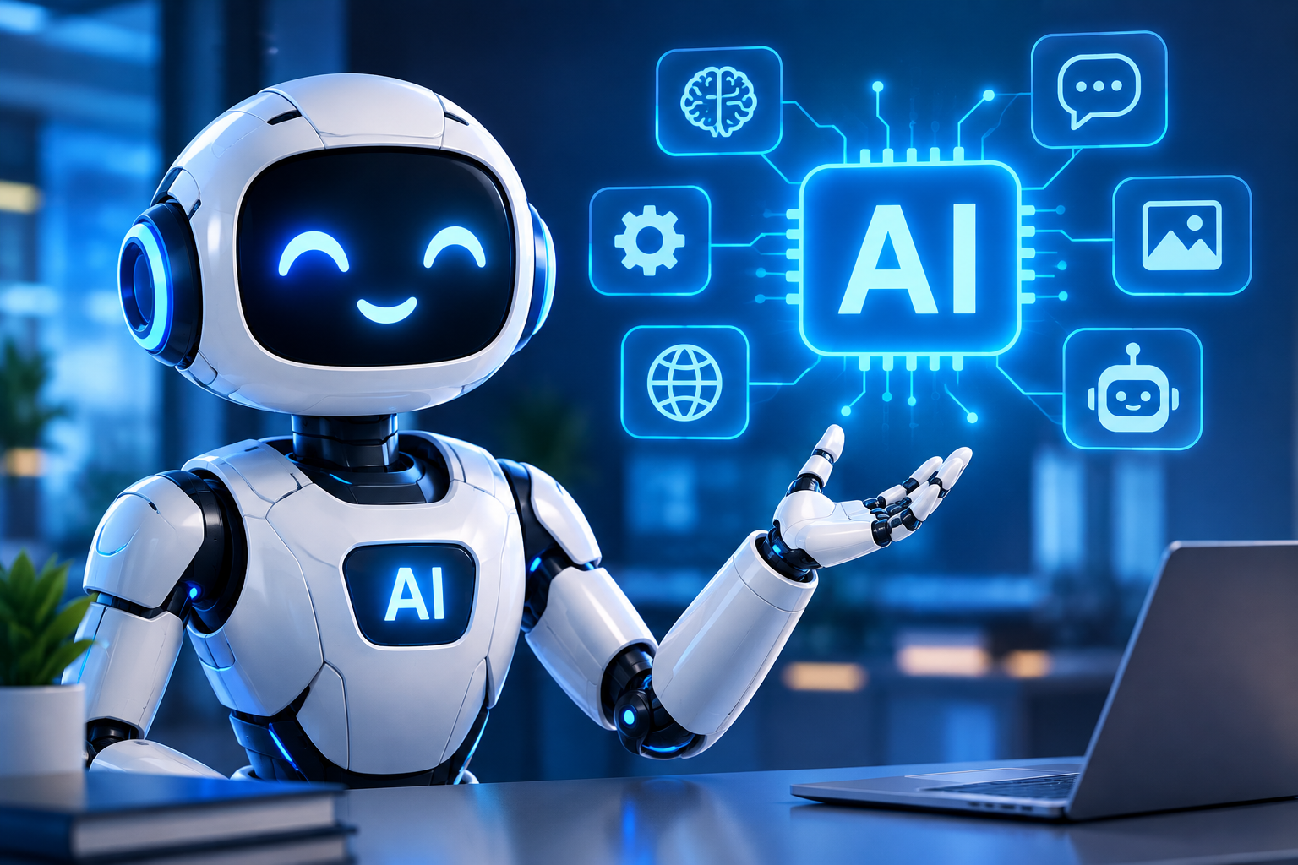
Introduction of AI
AI can automate tasks, making work faster and more efficient.
Artificial Intelligence (AI) is a technology that allows machines to perform tasks that normally require human intelligence.
AI can learn and analyze data to recognize patterns, solve problems, and make decisions.
AI is widely used in education, healthcare, banking, transportation, entertainment, and many other fields.

Slide 5
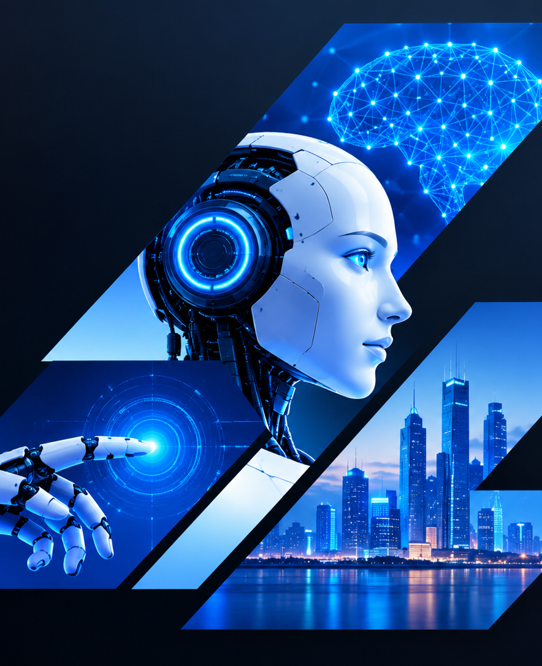
What is Ai ?
Meaning: AI stands for Artificial Intelligence.
Definition: AI allows computers to learn, think, and make decisions like humans.
How it works: It uses data, algorithms, and computer models to perform tasks.
Examples: ChatGPT, voice assistants, recommendation systems, and self-driving technology.

Slide 6
Different use of AI in different working sector
Healthcare- helps doctors analyze medical information.
Education- Enables personalized learning.
Finance- Detects funds and analyses transactions.
Transportation- supports navigation and autonomous system.
Entertainment-Recommends content and autonomous systems.
Smart technology- power smart devices and assistants.

Slide 7
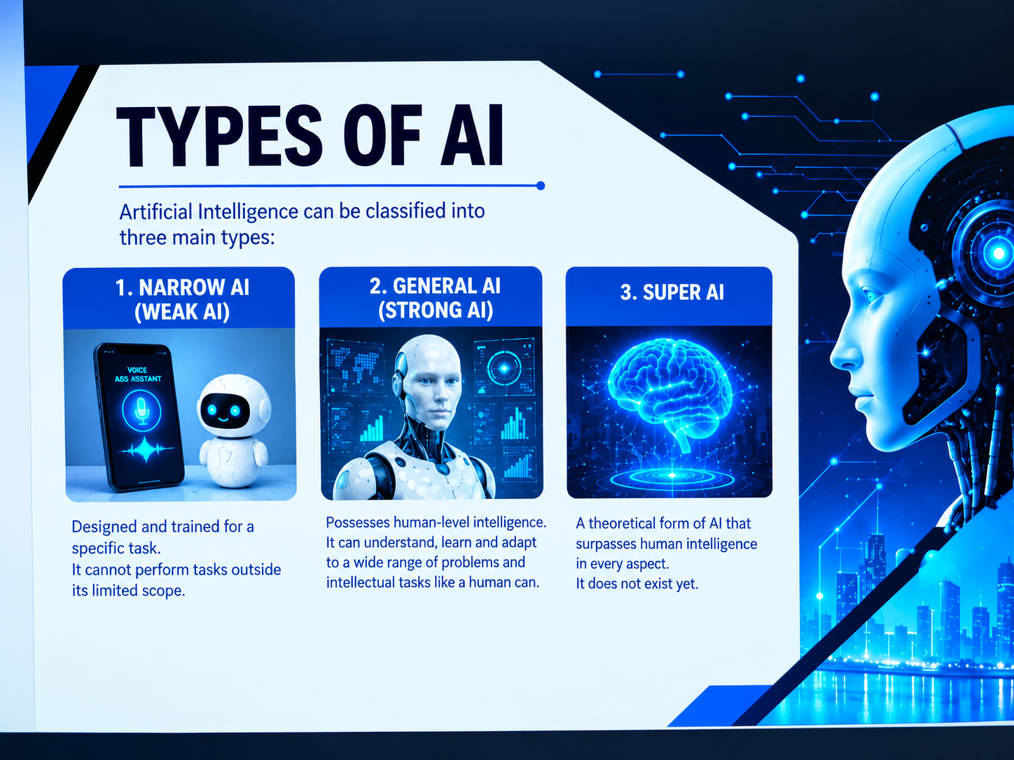
TYPES OF AI
There are three type of Ai
Narrow AI- Designed for a specific task.
General AI-would perform many intellectual task like human.
Super AI-A theoretical AI that would exceed human intelligence.

Slide 8
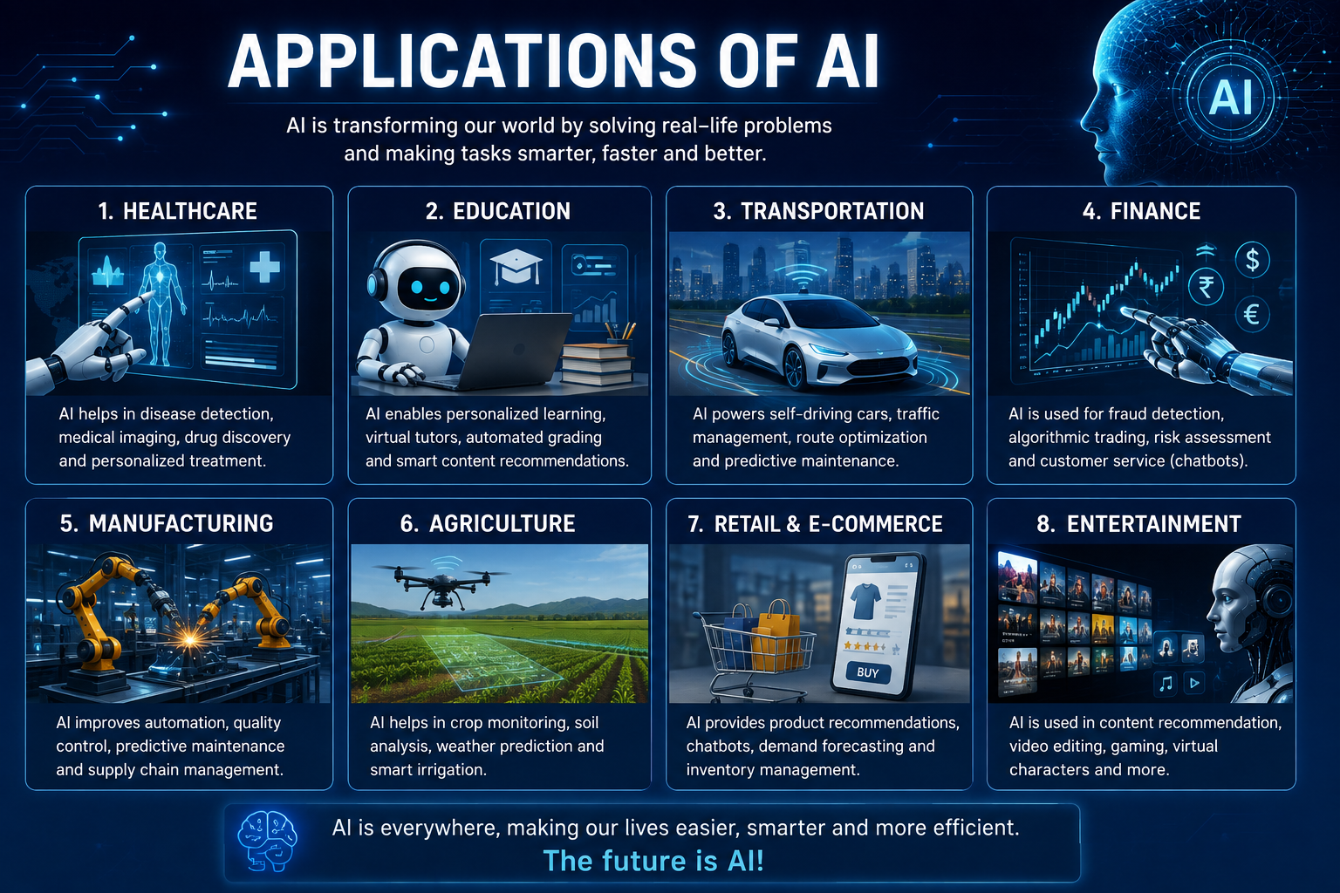
Applications of AI
Healthcare-Disease detection, medical diagnosis and drug discovery.
Education-personalized learning, virtual tutors and automated grading.
Transportation-self-driving cars, traffic management and route planning.
Finance- fraud detection, risk analysis and online banking assistance.

Slide 9
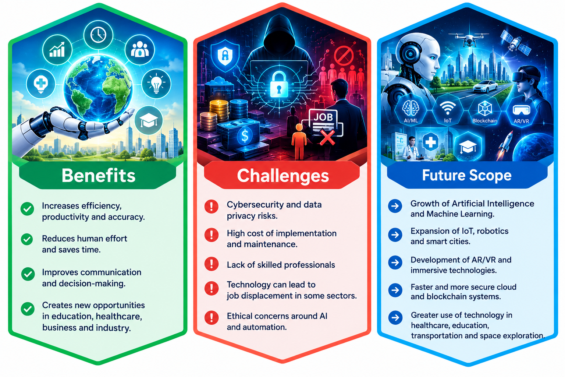
Benefits, Challenges & Future Scope
Benefits
Increases efficiently , productivity and accuracy.
Reduces human effort and saves time.
Improves communication and decision-making.
Creates new opportunities in educations , healthcare , business and industry.

Slide 10
Benefits, Challenges & Future Scope
Challenges
Cybersecurity and data privacy risk.
High cost of implementation and maintenance.
Lack of skilled professions.
Technology can lead to job displacement in some sectors.
Ethical concerns around AI and automation.

Slide 11
Benefits, Challenges & Future Scope
Future scope
Growth of LOT , robotics, and smart cities.
Faster and more secure clod and block chain system.
Greater use of technology in healthcare, education, transportation, and space exploration.

Slide 12
Conclusion
It makes tasks faster, easier, and more efficient.
AI is useful in education, healthcare, business, transport, and many other fields.
We should use AI responsibly and wisely.
The future of AI is full of new possibilities and opportunities.
“AI is not the future alone—it is a tool shaping our present.”

Slide 13
THANK YOU

